Slide 1
Mishap Training
NEPMU-6

Slide 2
Classification
Class A:
  Total damage of DoD or non-DoD property = $2 million or more
  DoD aircraft is destroyed
  An injury/illness results in a fatality or permanent total disability

Slide 3
Definition
Permanent total disability = A non-fatal injury or occupational illness, which in the opinion of competent medical authority permanently incapacitates someone. Also, the loss of the following body parts or the use thereof during a single mishap is a permanent total disability:
  (1) Both hands
  (2) Both feet
  (3) Both eyes
  (4) A combination of any two of these body parts.
Notes:
Ento eyewash station story

Slide 4
Classification
Class B:
  Total damage of DoD or non-DoD property = $500,000 to $2 million
  An injury/illness results in a permanent partial disability
  3 or more personnel are hospitalized for inpatient care (beyond observation)

Slide 5
Definition
Permanent partial disability = An injury or occupational illness, that results in permanent impairment or loss of any part of the body (e.g., loss of the great toe, thumb, or a non-repairable inguinal hernia, traumatic acute hearing loss of 10 dB or greater documented by medical authority). Exceptions include the following:
  (1) Loss of teeth.
  (2) Loss of tips of fingers/toes without bone loss.
  (3) Repairable hernia.
  (4) Disfigurement.
  (5) Sprains or strains that do not cause permanent limitation of motion.

Slide 6
Classification
Class C:
  Total damage of DoD or non-DoD property = $50,000 to $500,000
  An event involving one ore more DoD personnel that results in one or more days away from work

Slide 7
Other Reportable Mishaps
Fatalities and injuries that occur during PCS orders (gaining Command does report)
Fatalities or permanent total disabilities that are the result of a medical event that commenced w/in one hour of a Command-sponsored PT, PRT, PFT, or PFA.
All GMV mishaps resulting in > $5,000 DoD or private property damage and/or injury of DoD or non-DoD personnel

Slide 8
Other Reportable Mishaps
Work-related STS
Work-related illness and injury whether or not involving further medical treatment or any time away from work.
Any work-related needle stick injury or cut from a sharp object that is contaminated with another person’s blood or other potentially infectious material.

Slide 9
WESS
Web-Enabled Safety System (WESS).
All Navy and Marine Corps reportable mishaps shall be reported using WESS.
All mishap reports must be submitted in WESS in 30 days.
WESS is password protected.

Slide 10
Class A Requirements
Safety Investigation Board (SIB)
  Made up of 3 to 5 members
  Must be appointed in writing
Notify the Naval Safety Center within 8 hours at:
  757-444-3520

Slide 11
HAZREP
A HAZREP is intended to be submitted to provide information on problems with widespread relevance will help reduce mishaps.
HAZREPs are submitted electronically, using WESS for:
  A hazard or near-mishap and the recommended remedial or corrective action taken to eliminate the hazard.
  A previously unrecognized hazard so that another agency may determine appropriate corrective action to eliminate the hazard.
  A significant, unexpected, or unusual occupational overexposure, as the result of industrial hygiene assessments of industrial processes or operations, to bring that potential exposure to the attention of medical and safety authorities.

Slide 12
What to do…
When you get injured beyond first aid, at work or off-duty (even on leave), you must do the following:
  Inform the Chain of Command as soon as possible, including the Safety Officer (or SPO if I’m on leave)
  Keep records of damage, especially for POVs
  In person or by phone, give a detailed description of what happened
  Know that more questions will probably surface as the report progresses
Remember that we are not here to get you in trouble, but to keep you safe!

Slide 13
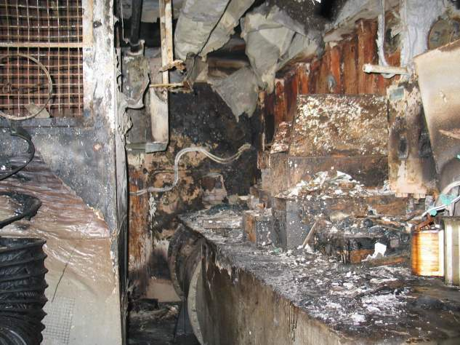
HAZMAT Stowage
Why is it important to store HAZMAT correctly onboard a ship?
Notes:
Fire/Smoke/water damage to AC&R shop of the GW

Slide 14
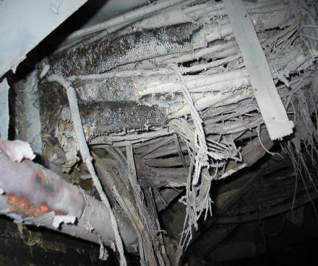
That’s why…
The USS George Washington’s CHENG spotted 300 gallons of flammable oil illegally stored below the carrier’s deck plates and ordered it moved.
But 90 gallons were stashed in an uptake space instead, later becoming fuel for the May 22 blaze that cost the Navy $70 million and several months of ship repairs.

Slide 15
HAZMAT Locker Inspections
Always keep an eye out for illegal HAZMAT and inspect all satellite lockers when onboard a ship.
What the locker should be:
  Yellow in color
  Welded to deck
  Max of 30 gallons in one space
  PKP bottle in vicinity
  Self-closing & lockable
  Marked “Flammable” & “Warning, No Smoking, No Open Flames” & “During strip ship conditions…”
  Has current inventory posted
Notes:
Checklist is helpful

Slide 16
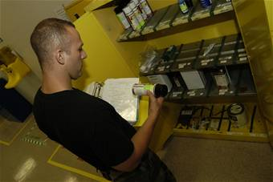

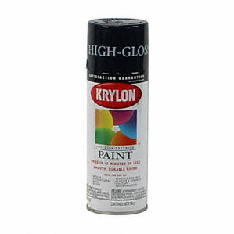
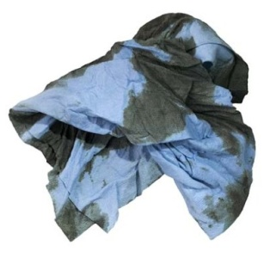
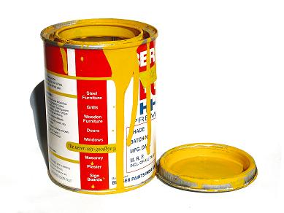
What it should not have…
Paint of any kind
Paper or rags
Incompatibilities
Spillage on shelves

Slide 17
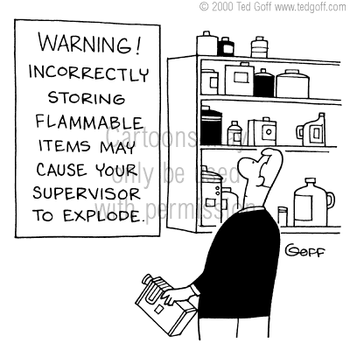
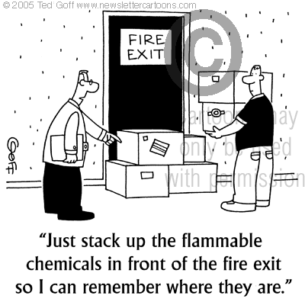
Any questions?

